Slide 1
Learning Reward for Robot Skills Using Large Language Models via Self-Alignment
Yuwei Zeng, Yao Mu, Lin Shao
by Yuzhe Zhou
2025-03-14

Slide 2



Authors
Yuwei Zeng NUS
Deploying robots into open-ended, unstructured environments
Yao Mu SJTU
Embodied AI, RL, Representation Learning
Lin Shao NUS
Intersection of robotics and AI

Slide 3
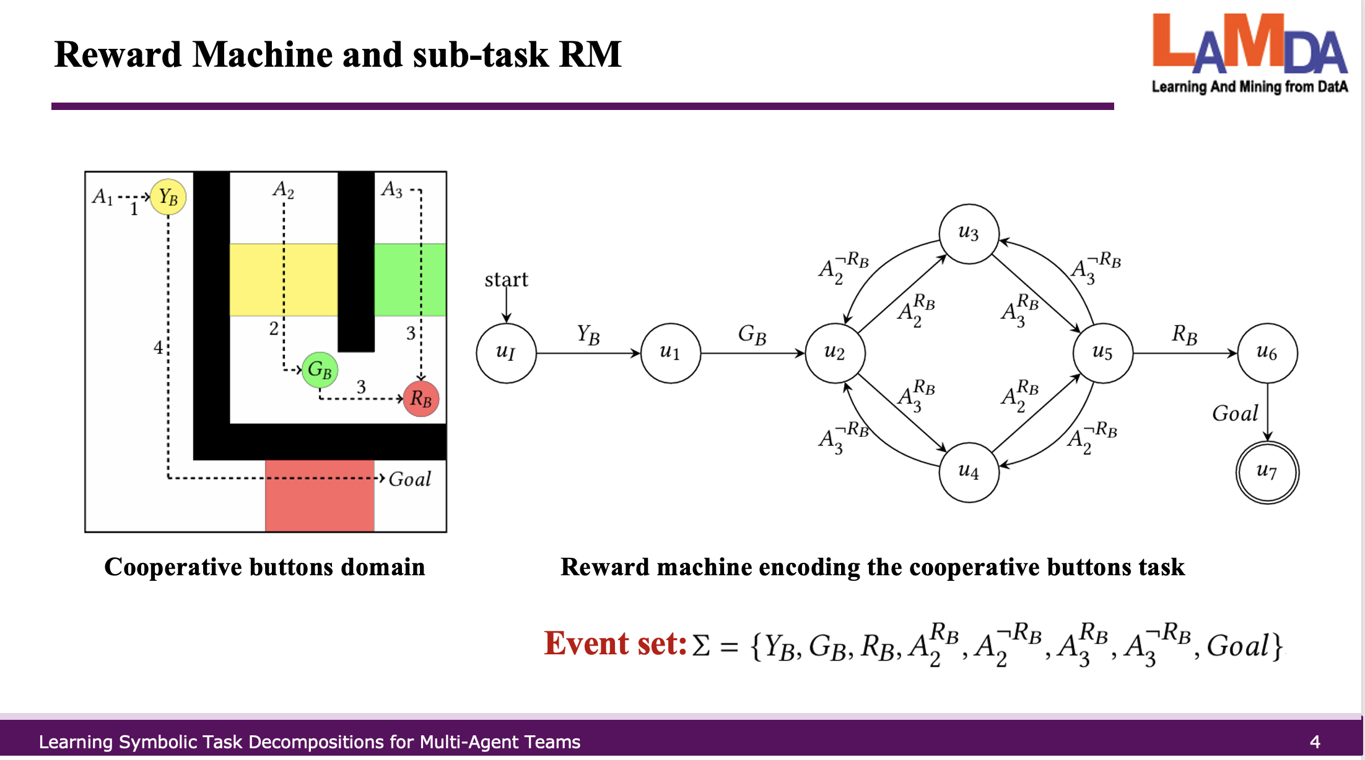
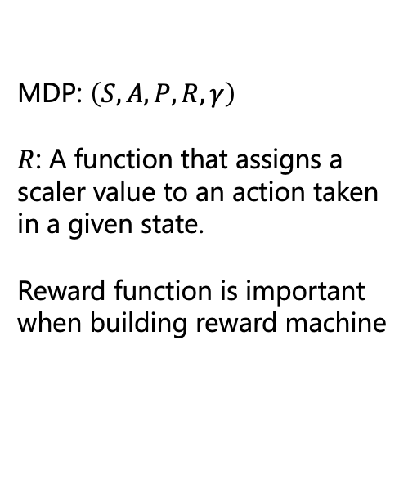
Background
MDP: $\left(S, A, P, R, γ\right)$
$R$: A function that assigns a scaler value to an action taken in a given state.
Reward function is important when building reward machine

Slide 4
Reward function Learning
Inverse Reinforcement Learning (IRL) studies how to autonomously learn a reward function from expert data.
Require human demonstrations
LLM contain valuable task-related knowledge that can potentially aid in the learning of reward functions.
Using LLM to learn reward functions still presents a challenge due to the task sensitivity to the exact numerical values while LLM show limited capacity.

Slide 5
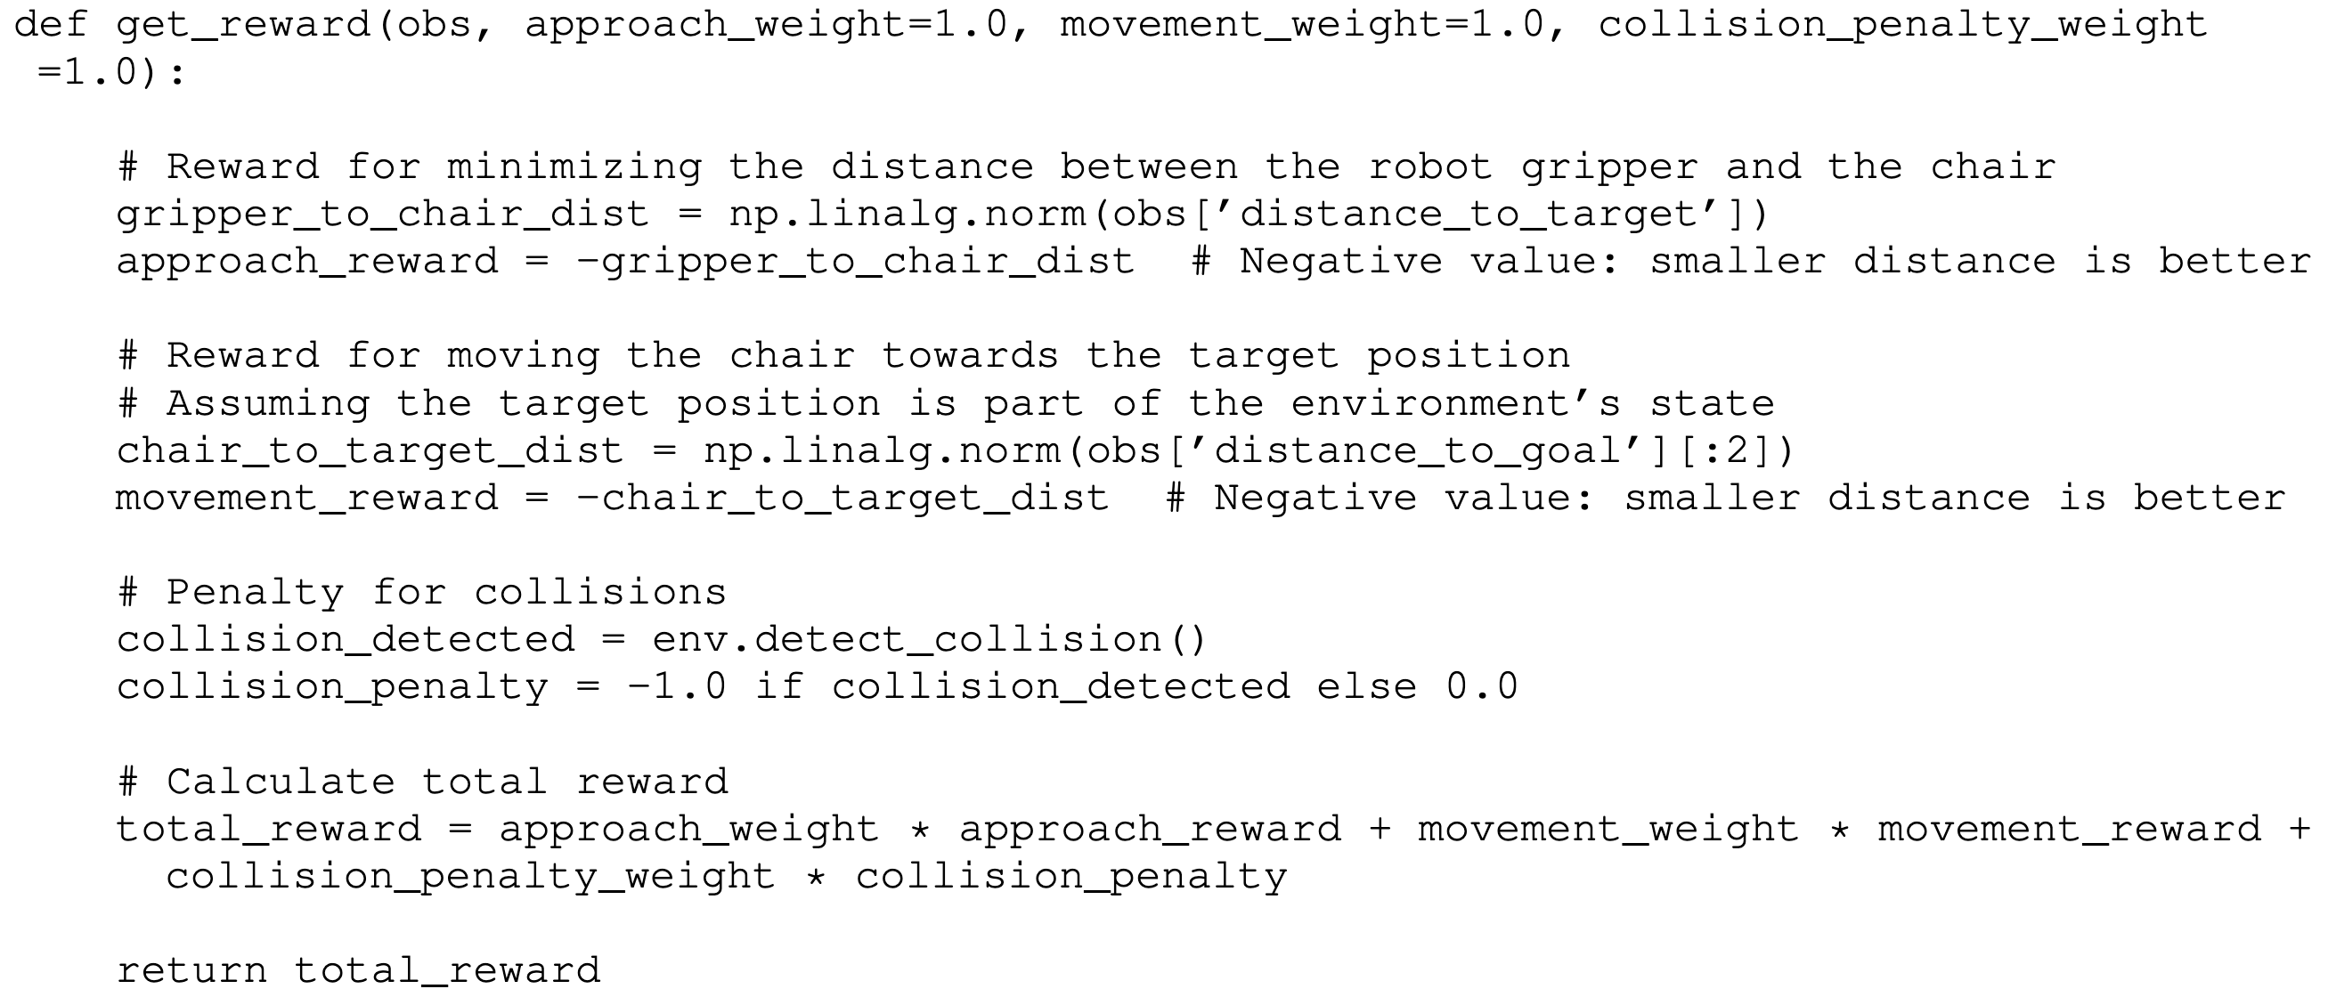
Example Reward Function

Slide 6
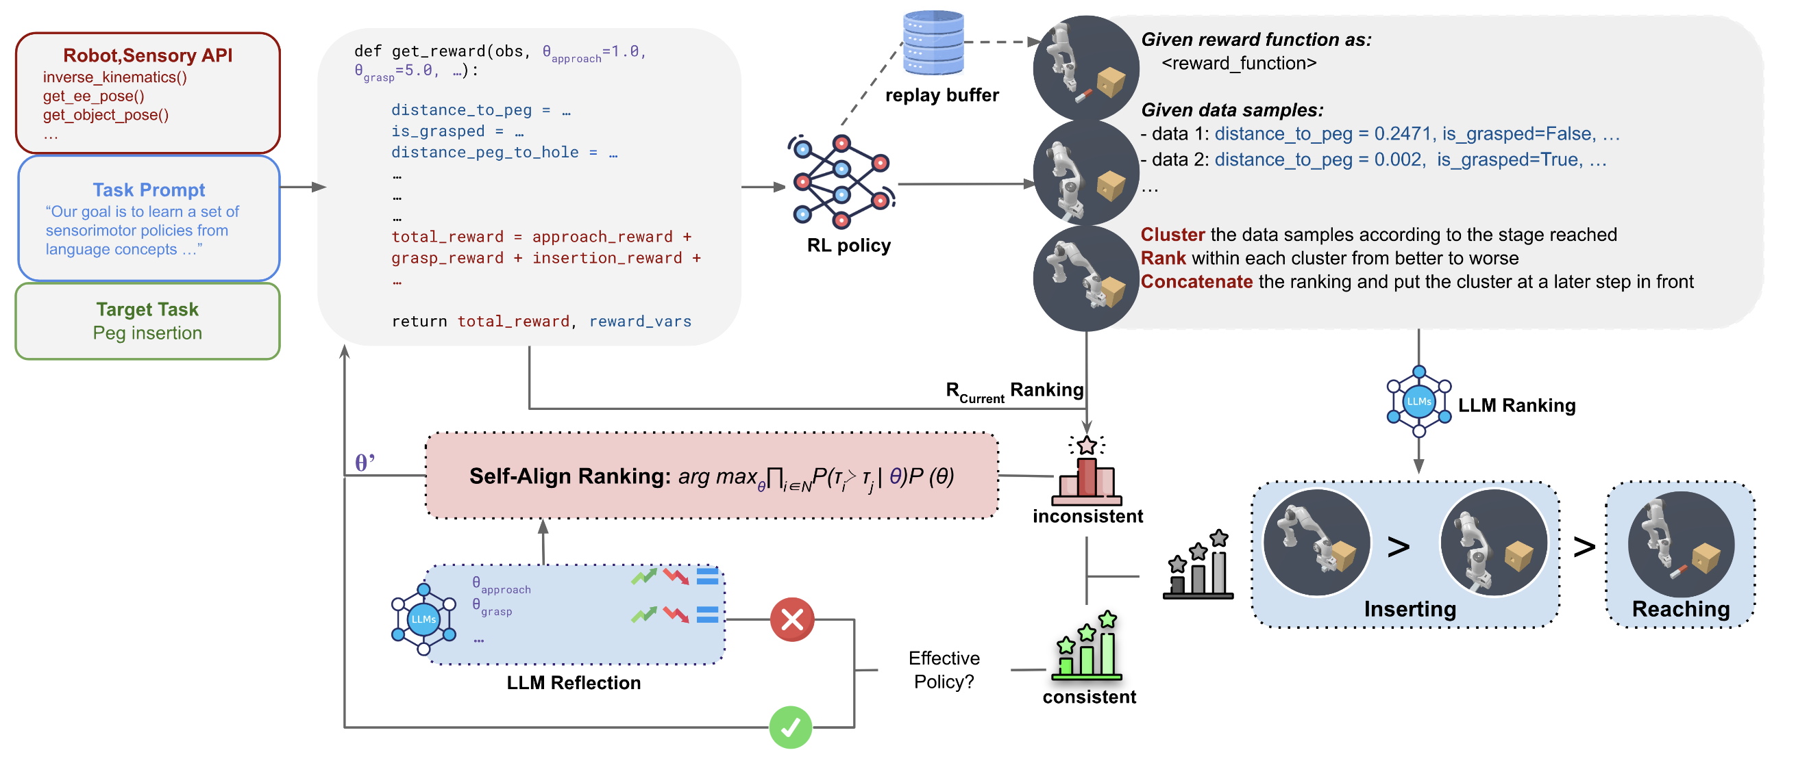
Pipeline

Slide 7
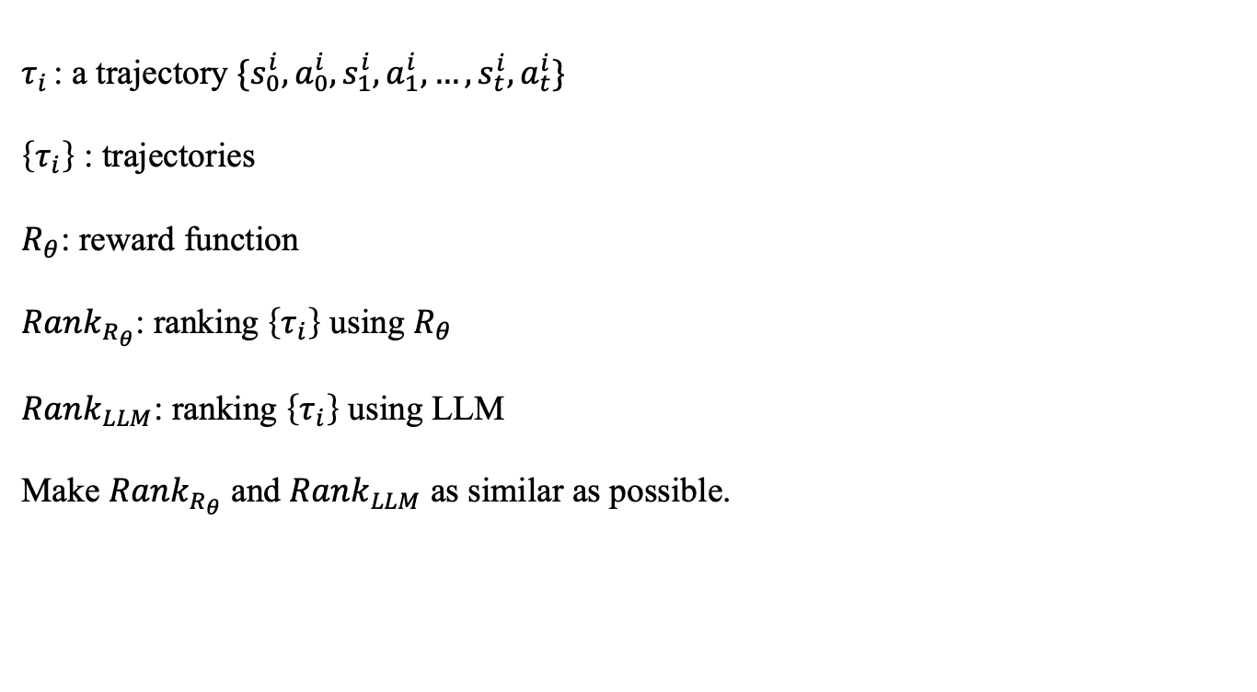
Pairwise Preference
$τ_{i }$: a trajectory $\{s_{0}^{i}, a_{0}^{i}, s_{1}^{i}, a_{1}^{i},…,s_{t}^{i},a_{t}^{i}\}$
$\left\{τ_{i}\right\}$ : trajectories
$R_{θ}$: reward function
$Rank_{R_{θ}}$: ranking $\left\{τ_{i}\right\}$ using $R_{θ}$
$Rank_{LLM}$: ranking $\left\{τ_{i}\right\}$ using LLM
Make $Rank_{R_{θ}}$ and $Rank_{LLM}$ as similar as possible.
Notes:
假如当前的reward function把靠近岩浆赋予高奖励，那么对于两个序列，序列一是靠近岩浆的序列，序列二是远离岩浆的序列，那么根据当前的reward function，序列一会比序列二更优，也就是它们之间存在序的关系，然而，LLM可能更倾向于后一个序列比前一个更好，这就产生了差异

Slide 8
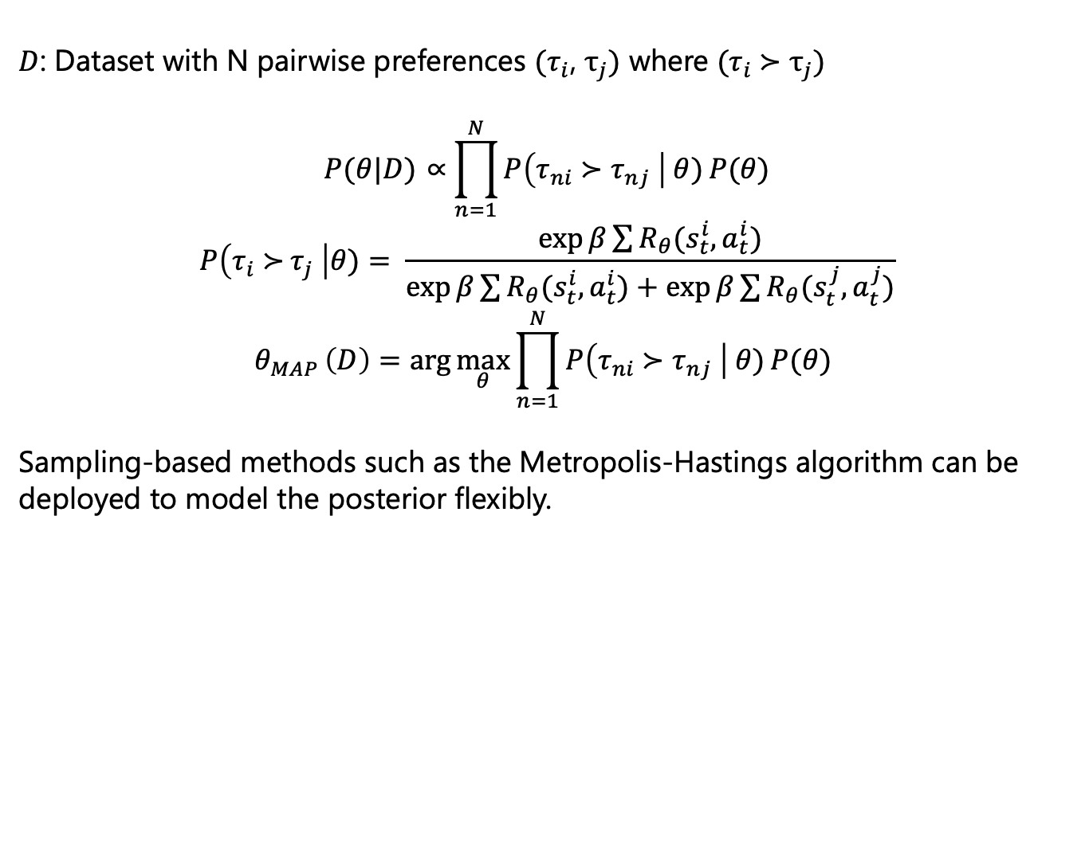
Reward Learning from Pairwise Preference
$D$: Dataset with N pairwise preferences $(τ_{i}\text{, }τ_{j})$ where $(τ_{i} \text{≻} τ_{j})$
$$P(θ|D) \text{∝}\prod_{n=1}^{N}{P\left(τ_{ni} \text{≻} τ_{nj} \right| θ)}P(θ)$$
$$P\left(τ_{i} \text{≻} τ_{j} \right|θ)= \frac{\exp{β}\sum{R_{θ}(s_{t}^{i}, a_{t}^{i})}}{\exp{β}\sum{R_{θ}(s_{t}^{i}, a_{t}^{i})}+\exp{β}\sum{R_{θ}(s_{t}^{j}, a_{t}^{j})}}$$
$$θ_{MAP }\left(D\right)=\arg{\max_{θ}{\prod_{n=1}^{N}{P\left(τ_{ni} \text{≻} τ_{nj} \right| θ)}P(θ) }}$$
Sampling-based methods such as the Metropolis-Hastings algorithm can be deployed to model the posterior flexibly.

Slide 9
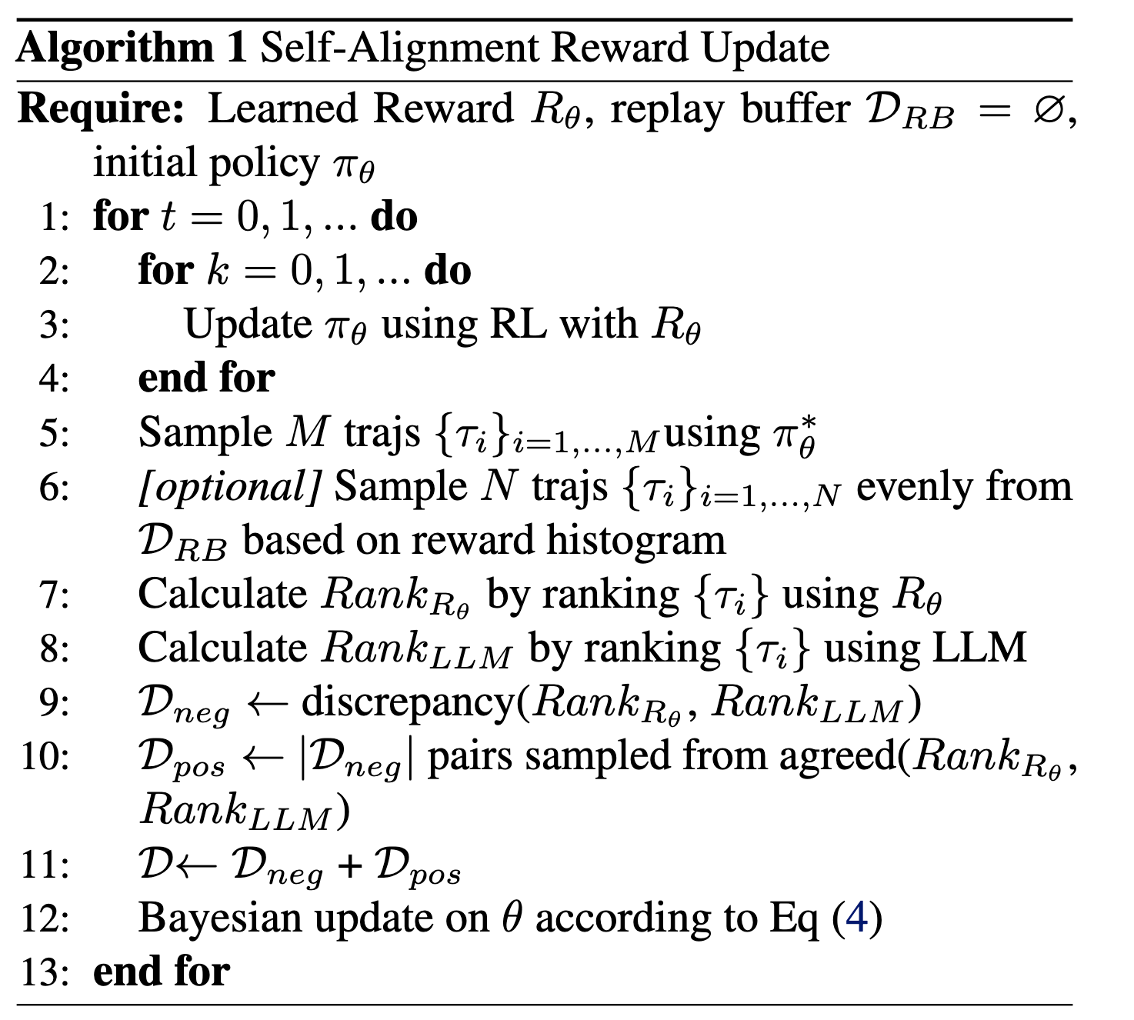
Self-Alignment Reward Update

Slide 10
Pipeline

Slide 11
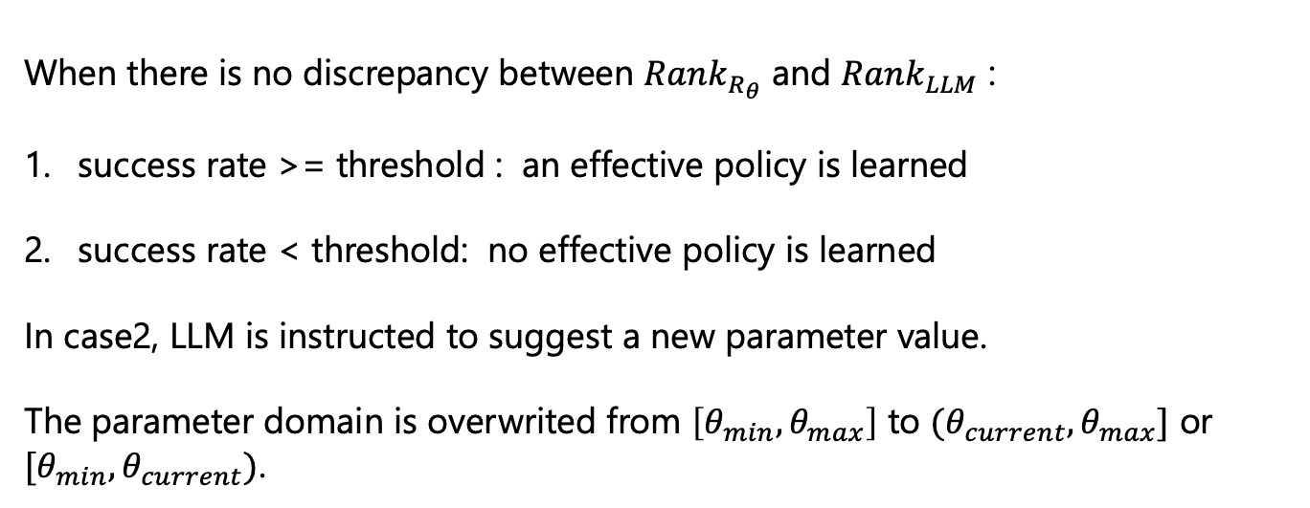
Restart
When there is no discrepancy between $Rank_{R_{θ}}$ and $Rank_{LLM}$ :
success rate >= threshold : an effective policy is learned
success rate < threshold: no effective policy is learned
In case2, LLM is instructed to suggest a new parameter value.
The parameter domain is overwrited from $\left[θ_{min},θ_{max}\right]$ to $(θ_{current},θ_{max}]$ or $[θ_{min},θ_{current})$.

Slide 12
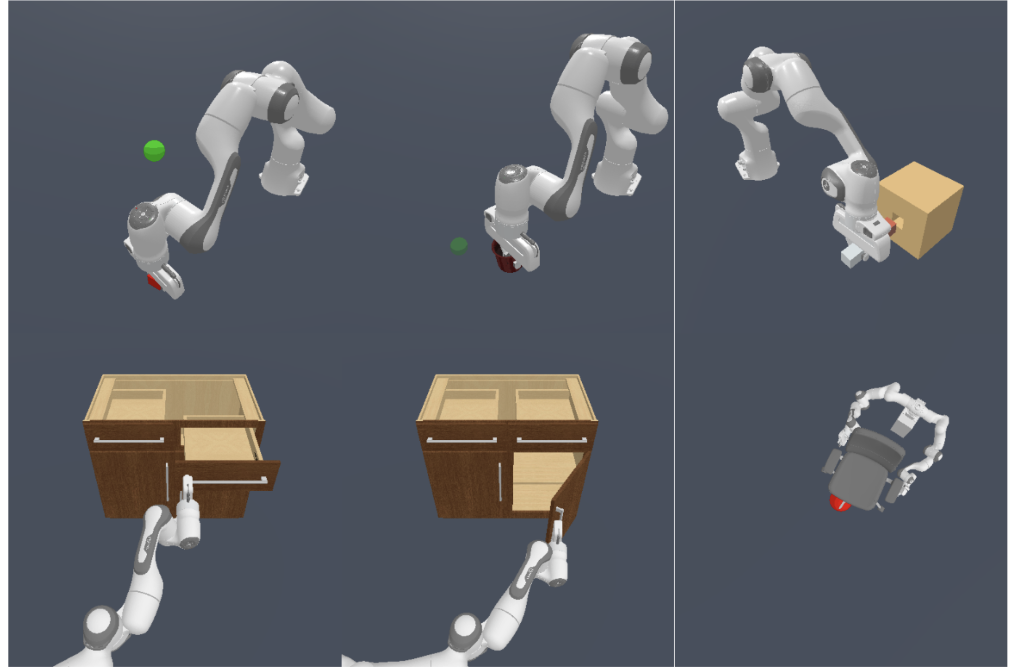
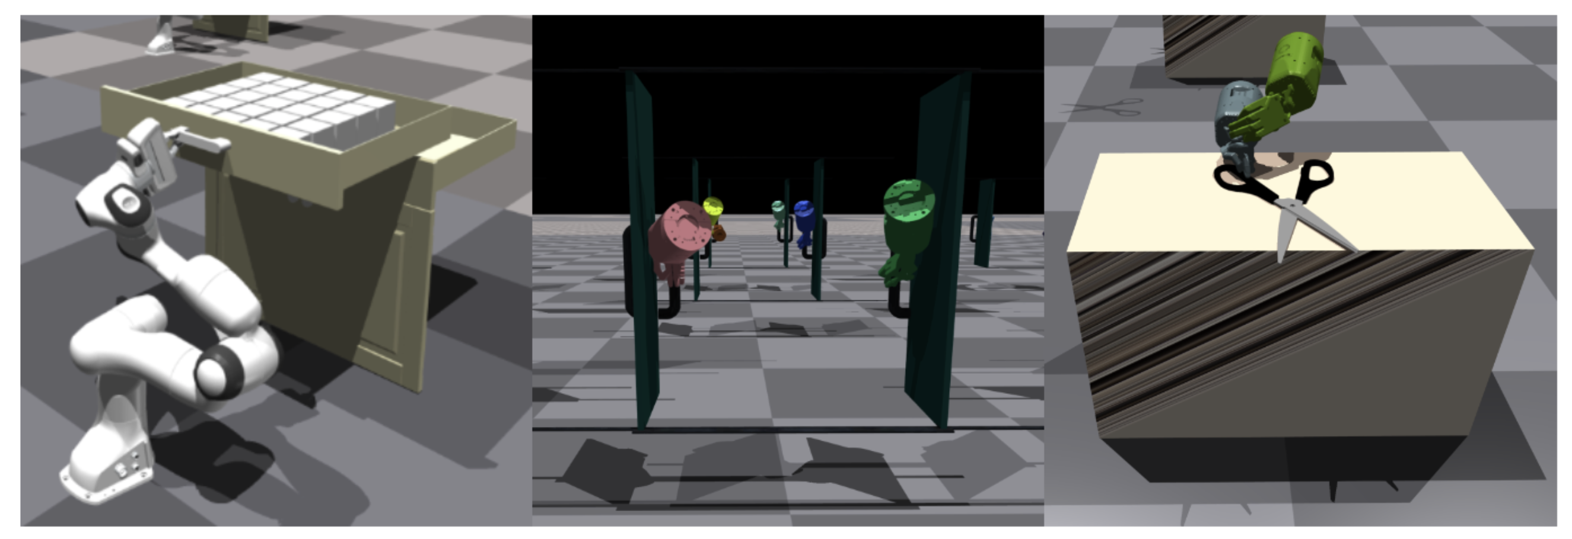
Experiment

Slide 13
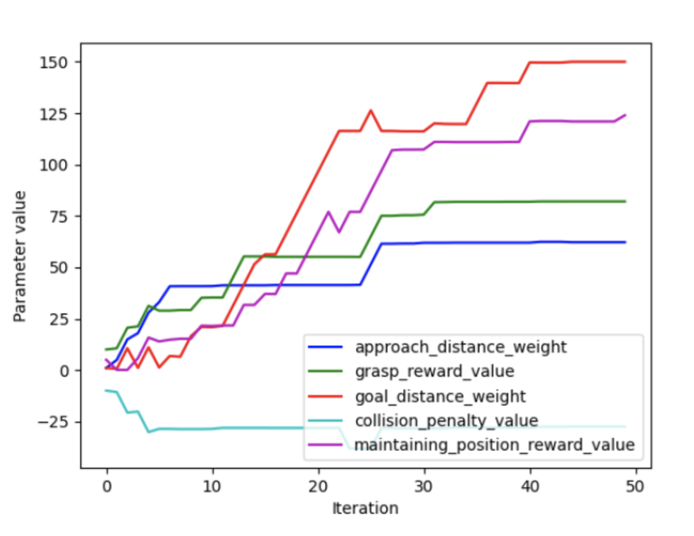
Parameter Value

Slide 14
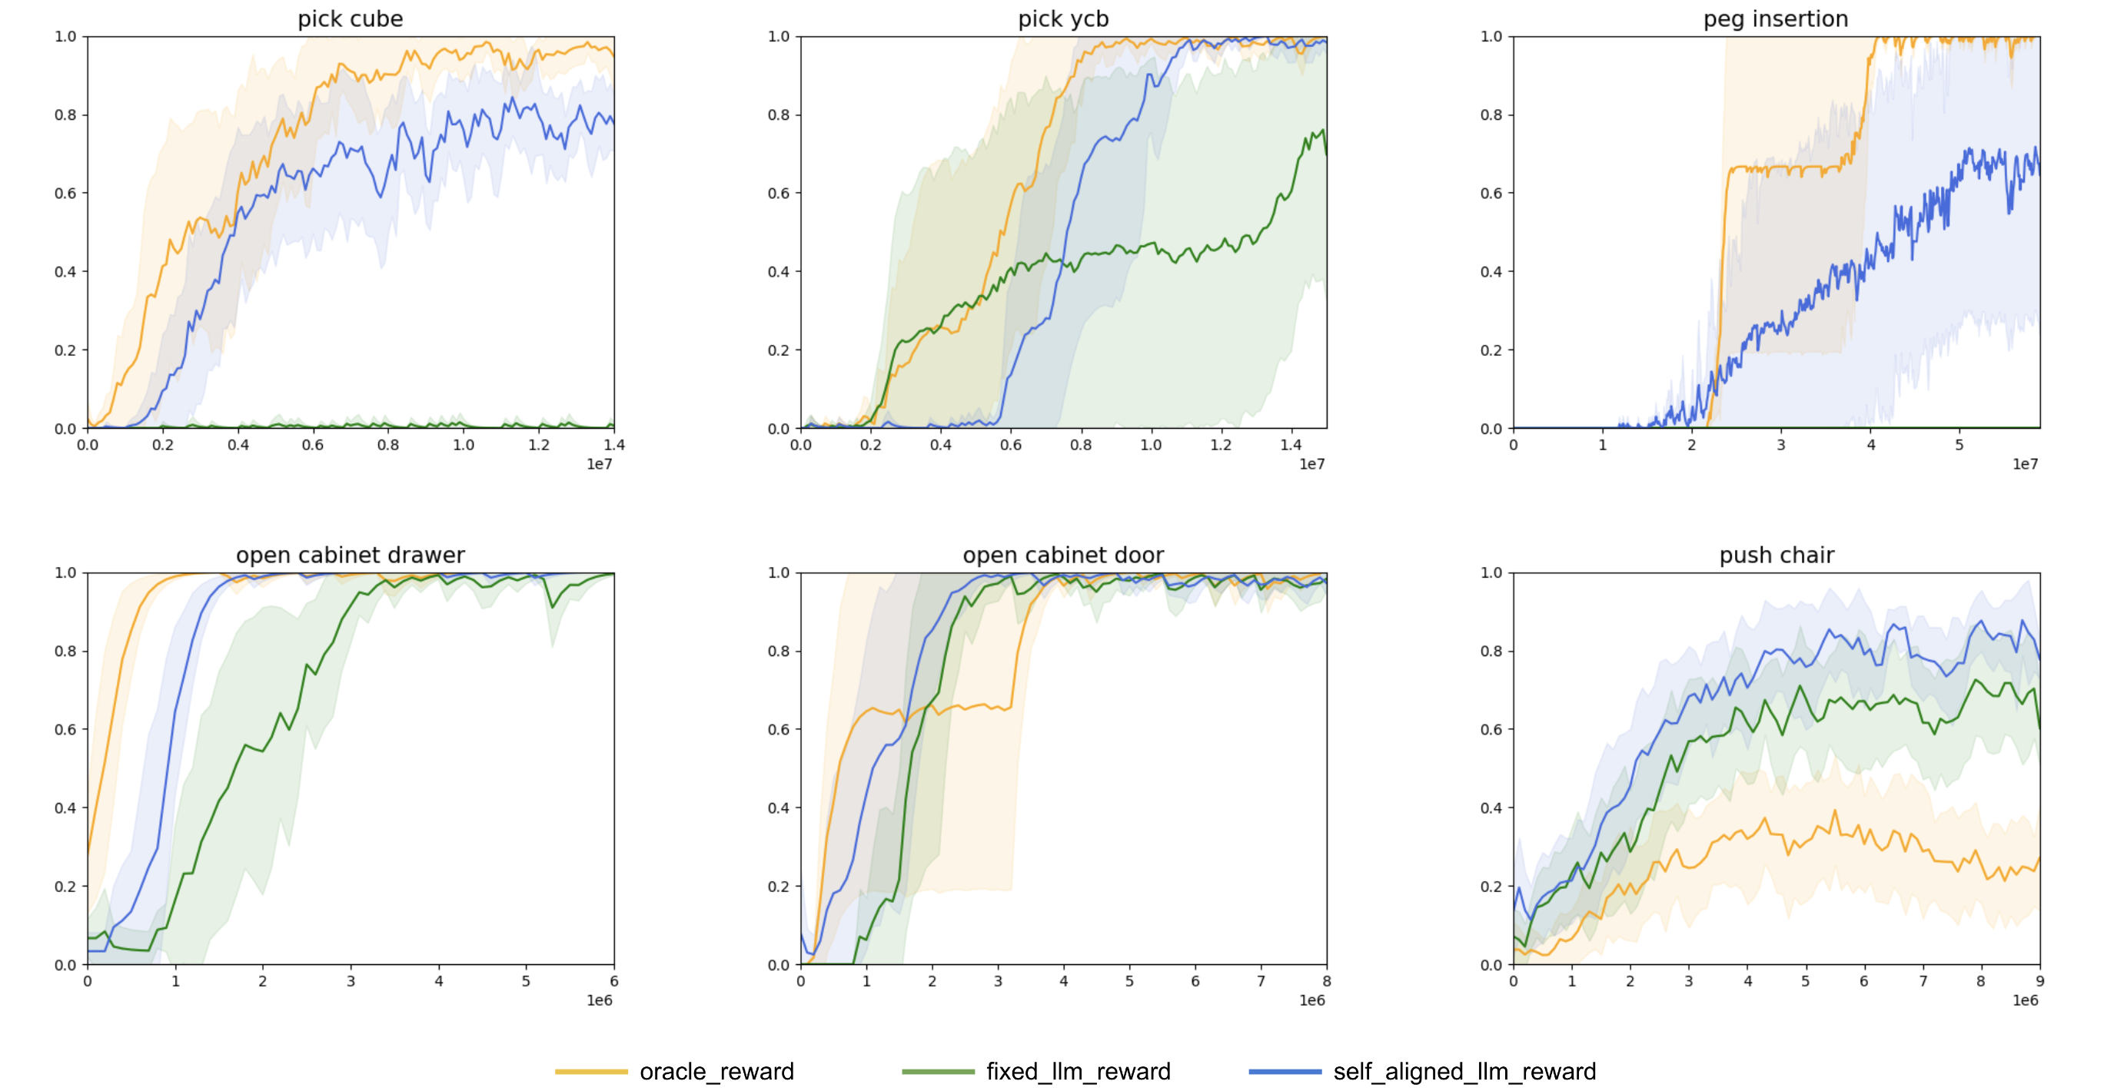
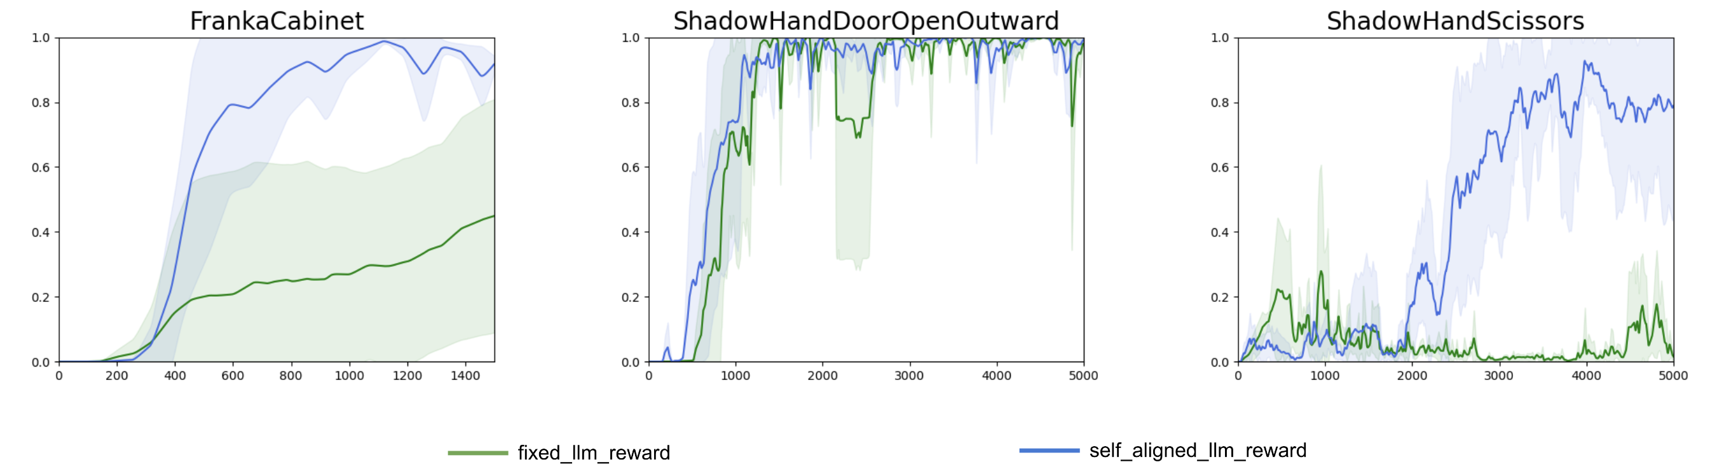
Success Rate

Slide 15
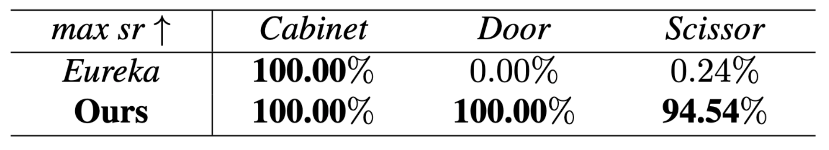
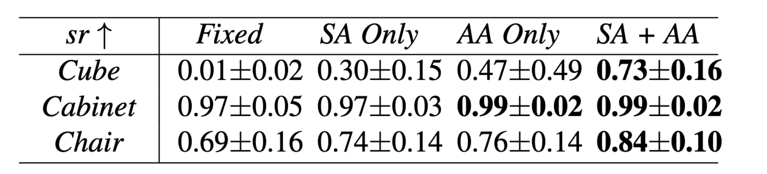
Success Rate

Slide 16
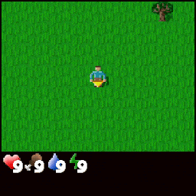
Summary
Pros:
Learning Reward function using LLM
Without human demonstrations
Cons:
Only tested with GPT-4
Inductive bias of LLM

